Slide 1
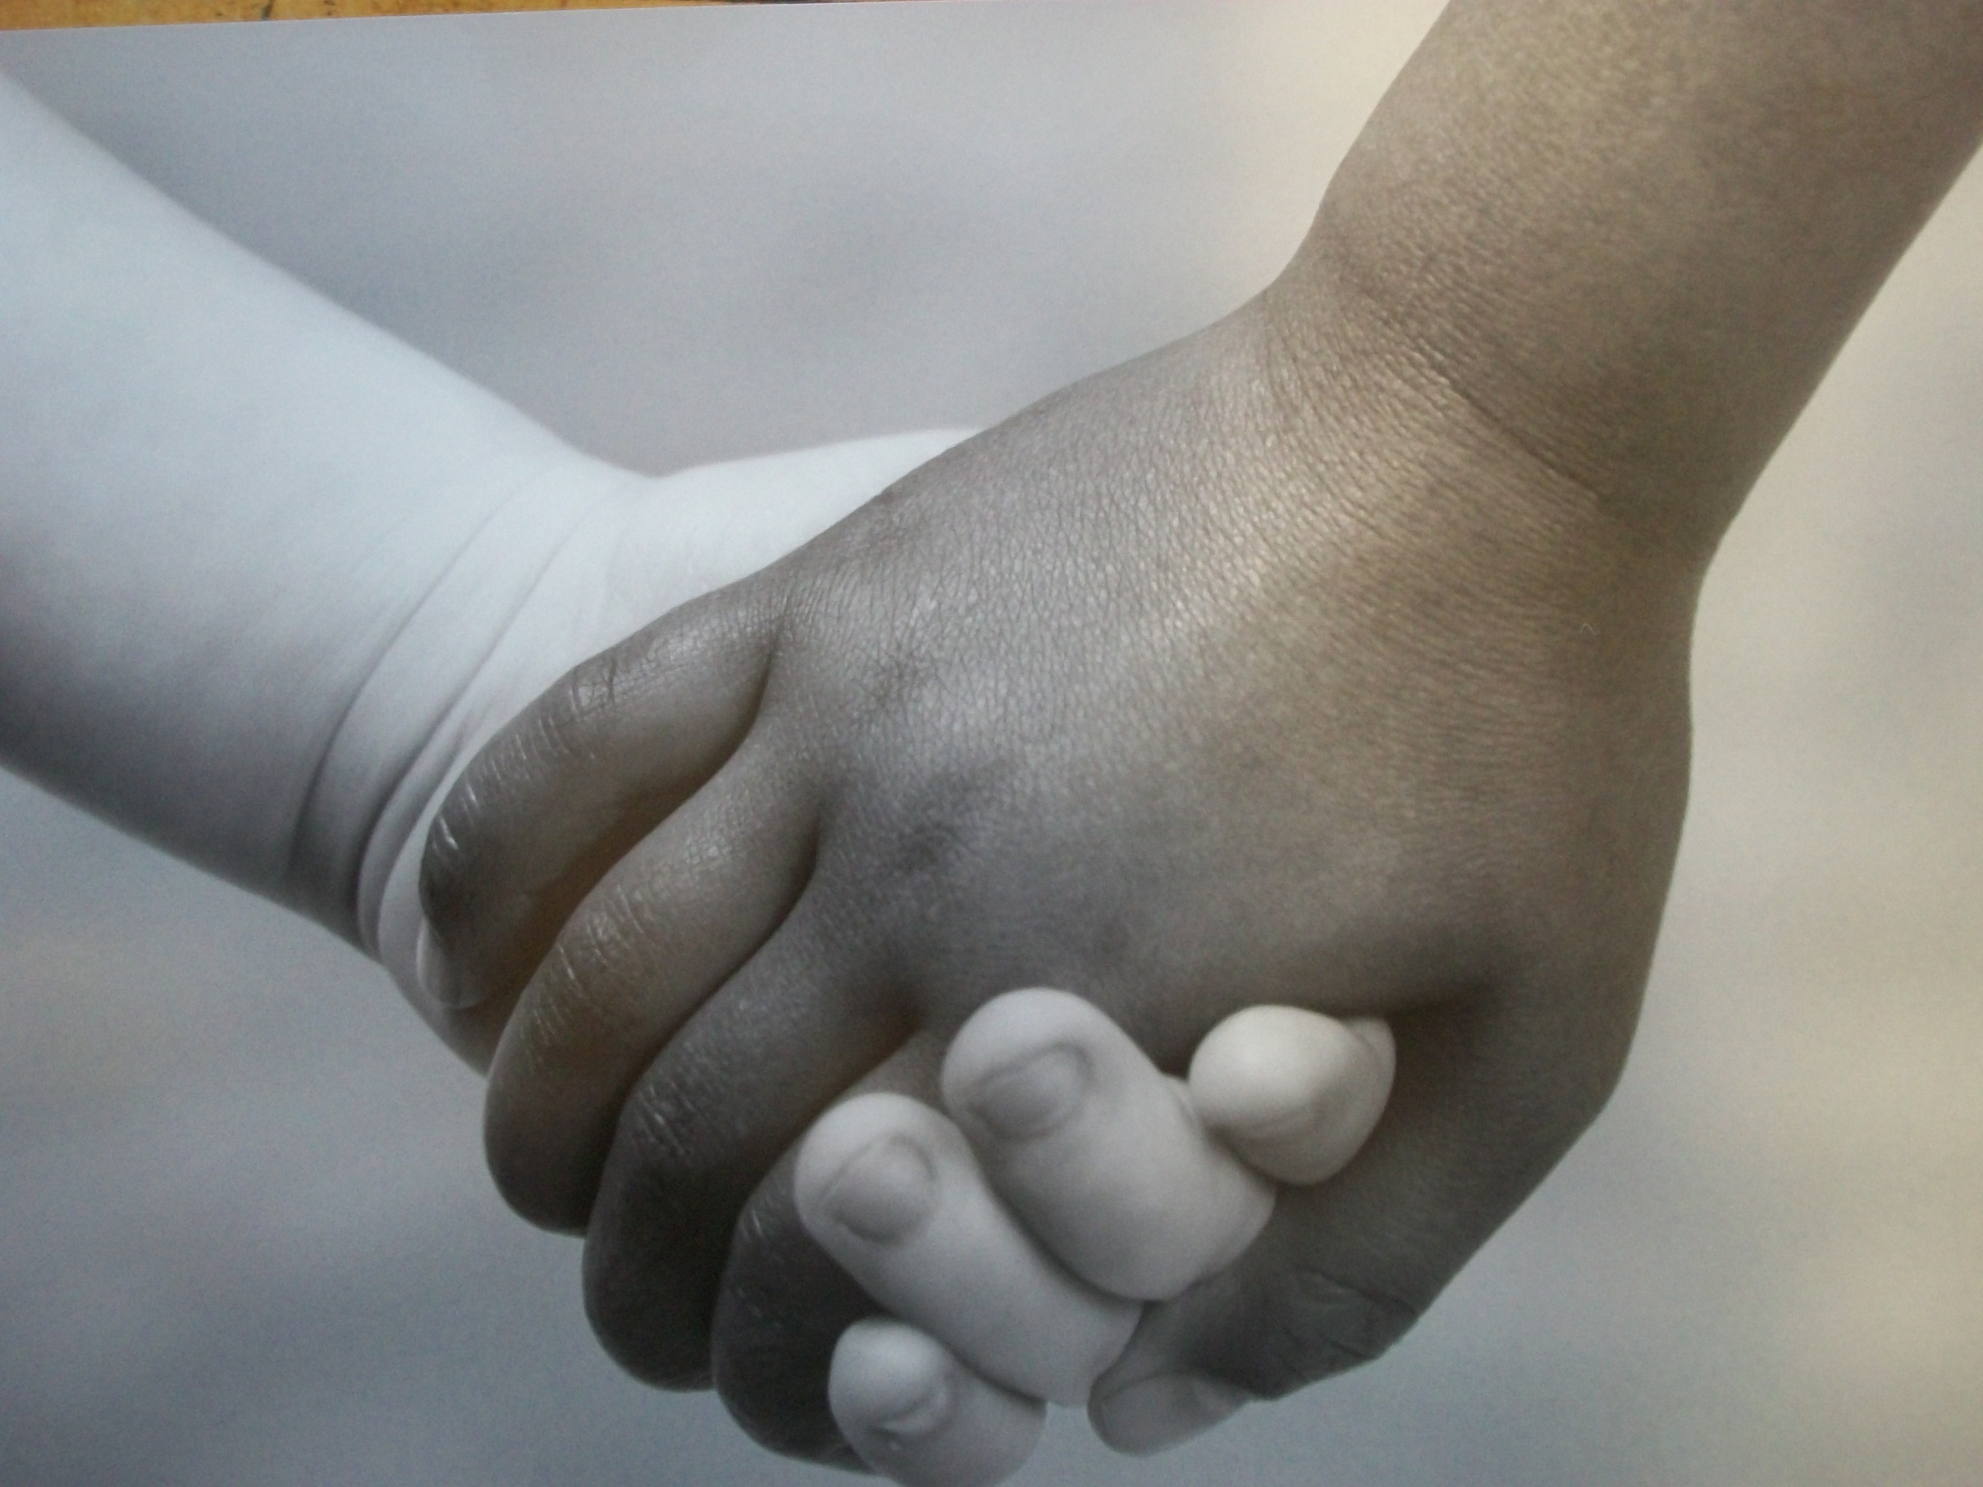

Slide 2
Class: Reading Unit: Introduction to Lit. Unit on Freak the Mighty by Rodman Philbrick
Teacher: Mrs. Joy Schott
School: Burwell Public School
Objectives: TSW observe the picture and orally tell what is happening, Build a Word Bank-list the vocabulary (coming up with Level 2 words), and then list the words in the three – and four- box practice sheets (student activity sheet p. 157)
Set: See below Duration: 3-4 days
Day 1:
1st-To determine what the students already know-
**After viewing word list, have students write sentences using 2-3 of the words from the list- “Take 2/Take3”
Vocabulary to be Introduced:
discrimination ethnicity bullying people
tolerance friendship differences relationships
race culture peace behaviors
2nd- Teacher Models – write example sentences on the board, overhead, or Interwrite Board
3rd- Hand out 3-4 Box Practice Sheets (student activity sheet p. 157) and show the picture of holding hands. In groups of four students will fill in the boxes of the practice sheet.
4th- The group will then construct a sentence by selecting their top level words and read aloud to the class.
5th- Independent Practice- Each student will write a sentence from their own sheets
Give time to go over – rewrite their individual sentences replacing Tier 1 words with Tier 2 words
Day 2-
1st-Using the Responding to Reading: Free Response sheet (student activity sheet p. 149) students will respond to the video clip below.
http://www.cbsnews.com/stories/2009/01/02/assignment_america/main4696340.shtml?tag=currentVideoInfo;videoMetaInfo
Next pose the question- “If they can do it what is our excuse?” Group discussion
2nd – Begin reading the book Freak the Mighty by Rodman Philbrick

Slide 3
Day 3- Introduction to Different Types of Bullying
Teasing-Making fun of someone based on their appearance, abilities, ethnicity, culture, or any other defining chara.
Excluding-Purposely leaving someone out
Name-calling-Calling someone a mean name or using words that hurt
Emotional bullying-Hurting someone else by spreading lies, gossip, rumors, or spreading secrets or other things someone has been told in confidence
Body Language Bullying- Using faces, gestures, and body language such as rolling one’s eyes or whispering while looking at the target
Physical Aggression-Using physical force against someone on purpose
Relationship Aggression-Getting others to do something that is wrong, mean, or hurtful to another person
Cyberbullying- Using the Internet, e-mail, or text messaging to hurt someone else
1st- Put the name Ben Carson on the board and have students predict who he is.
2nd- Read the passage about Ben Carson from the book, Heading Out by Gloria Kamen, students will use Free Response Practice to respond to the reading stopping at various points in the passage for reflection
3rd- Group discussion
4th- Tying it all together- (Mosaic of Thoughts must have already been taught to students), Go back and have students “Annotate Text” using the codes on pp. 100-101
5th- Last Word Activity-Phrase given: “Bullies will only intimidate people who are much weaker than they are, because they are afraid of losing a fight.”
Example given by teacher-Child: “Dad, Joey keeps picking on me. How can I make him stop?” Father: “Try fighting back.” A bully is always a coward. Bill took advantage of the younger children, but he was quiet and docile around the older ones. A bully is always a coward.
5th – Read Chpts. 1-3 Freak the Mighty

